Slide 1





Machine Learning
ML
The science of enabling computers to learn from experience and improve performance without explicit programming
Data
Algorithms
Predictions

Slide 2












What is Machine Learning?
Definition
Machine Learning is a subfield of Artificial Intelligence (AI) that focuses on enabling computers to learn automatically from experience (data) and improve their performance on a specific task without being explicitly programmed.
ML Process
Key Characteristics:
Data + Algorithms + Experience → Predictions
Learns from data instead of being manually coded
Improves performance with experience
In Practice:
Discovers patterns and relationships in data
Spam detection: Classifies emails as spam or not spam
Makes predictions or decisions based on learned patterns
Credit scoring: Predicts loan repayment likelihood
Recommendation systems: Suggests movies, songs, or products

Slide 3


















Key Concept & Examples
Core ML Formula
Data
+
Algorithms
+
Experience
→
Predictions
Real-World Applications
Spam Detection
Credit Scoring
Recommendation Systems
ML learns to classify emails as spam or not spam from examples
ML predicts whether a person is likely to repay a loan based on past data
ML suggests movies, songs, or products based on user preferences
Classification
Prediction
Collaborative Filtering

Slide 4





















Types of Machine Learning
Supervised Learning
Unsupervised Learning
Reinforcement Learning
Definition: Model is trained using labeled data (input with correct output).
Definition: Model is trained on unlabeled data, and it must find hidden patterns or groupings.
Definition: Model learns through trial and error to achieve a goal, receiving rewards or penalties as feedback.
Examples:
Predicting house prices (Regression)
Examples:
Classifying emails as spam or not spam (Classification)
Customer segmentation using K-Means clustering
Examples:
Game-playing AI (like AlphaGo)
Market basket analysis
Self-driving cars
Uses clear correct answers to guide learning
Discovers patterns without knowing the answer
Learns by receiving rewards for good actions

Slide 5
















Supervised Learning
Definition
Types of Supervised Learning
Model is trained using labeled data (input with correct output).
Regression
Predicting continuous values
Key Characteristics:
Example:
Has a clear target variable
Predicting house prices based on features like area, rooms, and location.
Learning from examples
How Supervised Learning Works:
Classification
Predicting categories
Training Data
Algorithm
Model
Example:
Classifying emails as spam or not spam based on content and sender.

Slide 6

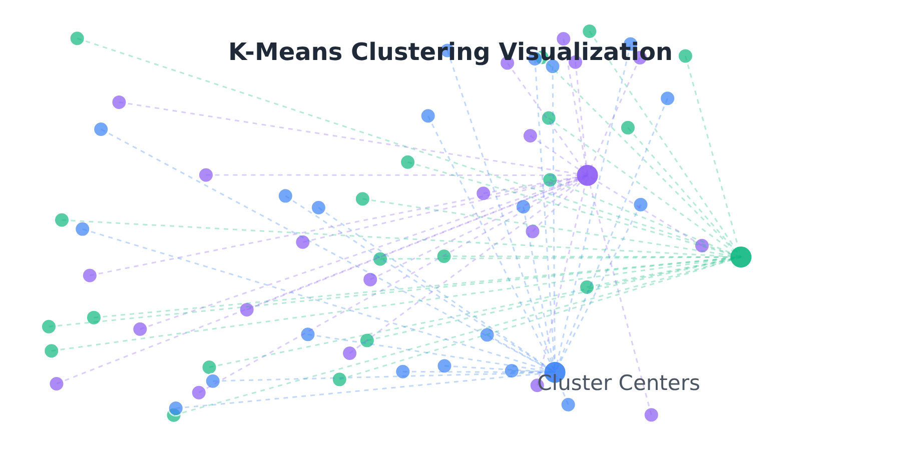








Unsupervised Learning
Definition
How Unsupervised Learning Works
Model is trained on unlabeled data, and it must find hidden patterns or groupings.
Key Characteristics:
Discovers patterns without labeled examples
Algorithms identify natural groupings in data
No correct output provided during training
Applications:
Customer Segmentation
Grouping customers with similar behaviors
Common Techniques:
K-Means Clustering
Partitions data into K distinct clusters
Market Basket Analysis
Finding items frequently bought together
Hierarchical Clustering
Creates a tree of nested clusters

Slide 7


























Reinforcement Learning
Definition
Model learns through trial and error to achieve a goal, receiving rewards or penalties as feedback.
Key Concepts:
Learning through experimentation
Agent
Environment
Makes decisions
Provides feedback
Positive feedback (rewards) for desired behaviors
Negative feedback (penalties) for undesired behaviors
Learning from experience over time
Applications:
RL Process:
Game-playing AI (like AlphaGo)
Self-driving cars
Observe
Decide
Act
Evaluate

Slide 8


























Machine Learning Pipeline Overview
A Machine Learning Pipeline represents the structured workflow that takes data from its raw state and transforms it into a trained and deployed model ready for real-world use. Each stage plays a crucial role in ensuring the model is accurate, reliable, and efficient.
1. Data Collection
2. Data Preprocessing
3. Feature Engineering
4. Data Splitting
Gather relevant data from multiple sources
Clean and prepare data for analysis
Create and select relevant features
Divide dataset for training, validation, and testing
5. Model Selection
6. Model Training
7. Model Evaluation
8. Hyperparameter Tuning
Choose algorithm based on problem type
Model learns from training data
Evaluate performance on test data
Optimize model performance
9. Deployment
10. Monitoring & Maintenance
Why It Matters
Ensures systematic approach to ML projects
Deploy model into production environment
Monitor performance and update as needed
Improves model accuracy and reliability
Facilitates reproducibility and scalability

Slide 9






























Data Collection & Preprocessing
Data Collection
Data Preprocessing
This is the first and most important step. Collect relevant, high-quality data from multiple sources:
Raw data is often incomplete, inconsistent, or noisy. Preprocessing ensures the dataset is clean and ready for analysis.
Databases
Sensors/IoT
Handle missing values (fill, drop, or estimate)
SQL, NoSQL
Real-time data
Remove duplicates and inconsistencies
Web
Records
Detect and correct outliers
Scraping, APIs
Surveys, logs
Convert categorical data to numeric using encoding
Example:
Scale numeric features (Normalization, Standardization)
For predicting house prices, collect data about area, rooms, location, and previous sale prices.
Example:
Replace missing "income" values with the median income of the dataset.
Data Preprocessing Workflow
Raw Data
Cleaning
Transformation
Validation
Ready for Analysis

Slide 10




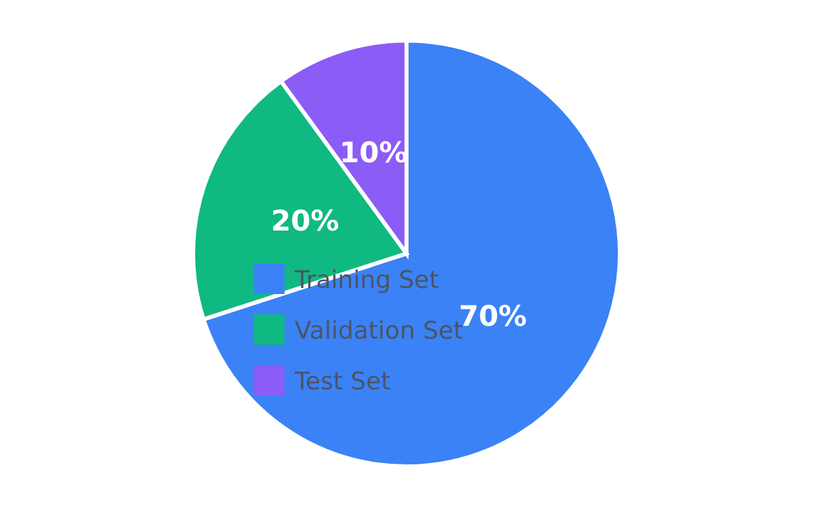











Feature Engineering & Data Splitting
Feature Engineering
Data Splitting
Creating effective features makes models more accurate.
Divide data into training, validation, and test sets for fair evaluation.
Feature Selection
Keep relevant features, remove irrelevant ones.
Feature Creation
Combine features to create new ones.
Dimensionality Reduction
Use PCA to simplify data while retaining information.
Key Insight
Good features lead to better model accuracy.
⚒️ Training Set
Validation Set
Test Set
~70% of data
~20% of data
~10% of data
Used to train the model
Used to tune hyperparameters
Used to evaluate final performance

Slide 11




















Model Selection & Training
Model Selection
Model Training
Choose the right algorithm based on the type of problem and data characteristics.
The model learns from training data by adjusting parameters to minimize prediction errors.
Regression
Training Process
Linear Regression, Decision Tree
Algorithms learn relationships between input features and target outputs
Classification
Logistic Regression, Random Forest
Adjusts internal parameters to minimize error
Clustering
K-Means, Hierarchical Clustering
Training time depends on data size and complexity
Example
Training vs. Testing
Use Logistic Regression to classify spam emails based on features like sender, subject, and content.
Training
Testing
Model learns from data
Evaluate model performance

Slide 12


















Model Evaluation & Hyperparameter Tuning
Model Evaluation
Hyperparameter Tuning
Evaluating how well the trained model performs on unseen (test) data to assess its accuracy and reliability.
Optimizing algorithm hyperparameters to improve model performance and prevent overfitting.
Evaluation Metrics:
Tuning Methods:
Classification:
Grid Search: Exhaustively tests hyperparameter combinations
Accuracy, Precision, Recall, F1-Score, Confusion Matrix
Random Search: Randomly samples hyperparameter combinations
Regression:
Bayesian Optimization: Uses probability to find optimal parameters
MSE, RMSE, R² Score
Clustering:
Common Hyperparameters:
Silhouette Score, Inertia
Learning rate (controls training speed)
Tree depth (for decision trees)
Example: A model with 92% accuracy on test data is considered strong if it generalizes well to new data.
Number of estimators (for ensemble methods)
Example: Adjusting the learning rate in a neural network to prevent overfitting and improve generalization.

Slide 13























Deployment & Monitoring
After developing a model, the next steps are crucial for real-world success: Deployment and Monitoring.
Deployment
Monitoring
Implementing the trained model into a production environment so it can make real-time predictions.
Continuously tracking model performance to ensure it remains accurate as new data arrives.
Deployment Options:
Key Monitoring Activities:
Web or Mobile Applications
Detect Model Drift
Integrate ML capabilities directly into apps
Identify when model accuracy drops over time
Cloud Services
Update or Retrain
AWS, Azure, Google Cloud platforms
Refresh the model with new data
APIs or Software Systems
Maintain Infrastructure
Expose ML capabilities through interfaces
Keep data pipelines and systems running
Example: Deploying a credit scoring model into a bank's loan approval system.
Example: A recommendation system retrained monthly to adapt to new user behavior.
Develop
Deploy
Monitor
Improve
Repeat

Slide 14


































ML Pipeline Summary
1
2
3
4
5
6
7
8
9
10
1
Data Collection
2
Data Preprocessing
3
Feature Engineering
4
Data Splitting
5
Model Selection
Gather raw data from multiple sources
Divide dataset
Choose suitable algorithm
Clean and prepare data
Select and transform features
Example: 70-20-10 ratio
Example: Customer purchase records
Example: Handle missing values
Example: Random Forest
Example: Create "Age_Group"
6
Model Training
7
Model Evaluation
8
Hyperparameter Tuning
9
Deployment
10
Monitoring
Learn from data
Use model in real apps
Maintain accuracy
Example: Fit model to training data
Test accuracy
Optimize performance
Example: Predict spam in Gmail
Example: Retrain with new data
Example: Compute F1-Score
Example: Grid Search
The ML pipeline ensures models are accurate, interpretable, scalable, and useful in real-world scenarios.

Slide 15











Key Takeaways
Critical insights for successful Machine Learning implementation
Data Quality
Iterative Process
Machine Learning depends heavily on data quality. Poor data leads to poor models, regardless of algorithm complexity.
ML is an iterative process where data and models are often revisited and improved over time for better results.
Real-world Deployment
Continuous Monitoring
The entire pipeline ensures models are accurate, interpretable, scalable, and useful in real-world scenarios.
After deployment, continuously monitor model performance and retrain with new data to maintain accuracy.
The ML Iteration Cycle

Slide 16






Thank You
Thank you for your attention!
We've explored the fundamentals of Machine Learning, from definition to pipeline implementation
Concepts
Pipeline
Applications
Definition, Types, and Core Algorithms
Data Processing to Deployment
Real-world ML Implementations
"Machine Learning depends heavily on data quality — poor data leads to poor models."
contact@mlresearch.ai

